Slide 1
Material Property Evolution
NE 591

Slide 2
Last Time
Wrapped up thermomechanics
Overviewed US fuel performance codes
Notes:
No class on 2/25, conference travel
Presentations on 2/27

Slide 3
Using everything we have learned so far, nothing changes once the fuel and cladding reach steady state

Slide 4
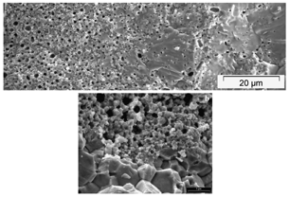
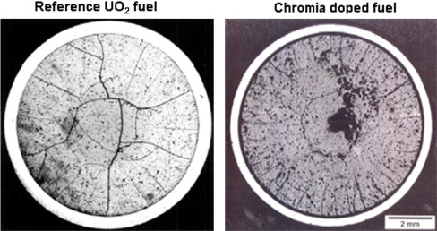
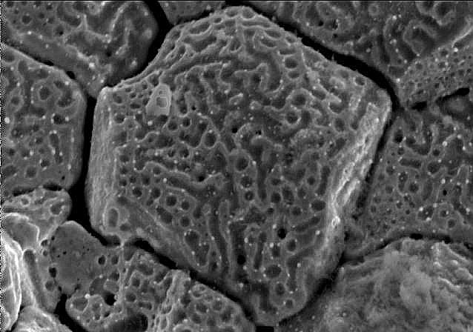
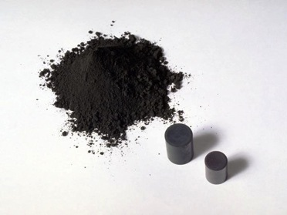
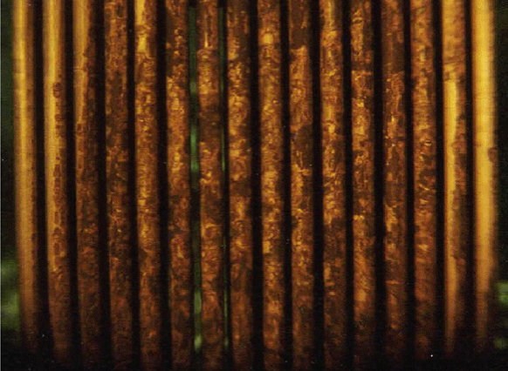
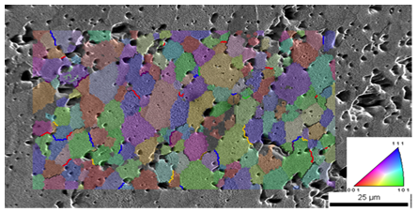
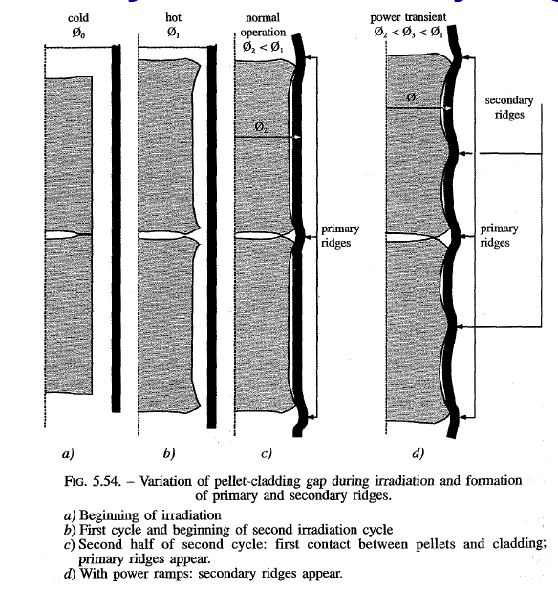
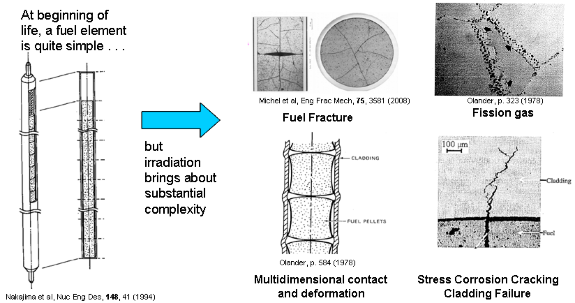
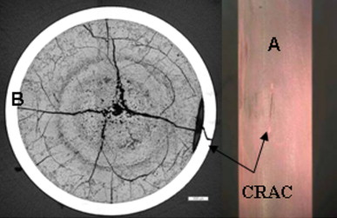
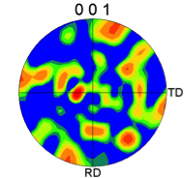
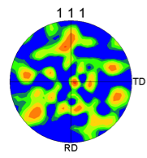
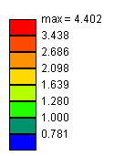
Property changes due to microstructure evolution during reactor operation must be considered
Insertion in reactor
Removal from reactor
Early life
Thermal expansion
Fracture
Point defect and fission gas generation
Fuel Densification
Mid Life
Point defect diffusion
Point defect clustering
Fission gas segregation to GB and voids
Bubble nucleation
Late life
Fission product swelling
Bubble percolation and fission gas release
Cladding creep
Fuel creep
Fuel failure
Pellet/cladding interaction
Cladding corrosion
Cladding fracture
Fuel Fabrication
Sintered UO²
Height 2 cm
Diameter 1 cm
~10 μm grain size
Density > 95%
Brohan 2000
From Pedro Peralta, ASU
Zinkle and Singh 2000
Santana et al. 2011

Slide 5
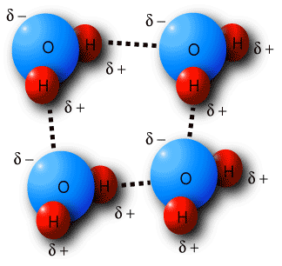
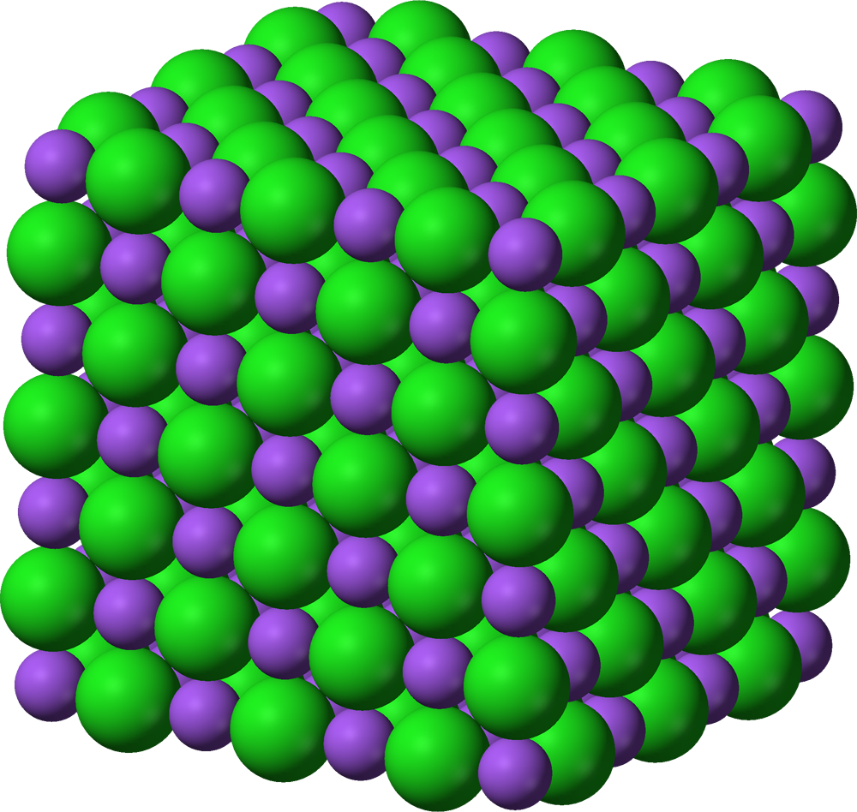
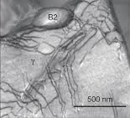
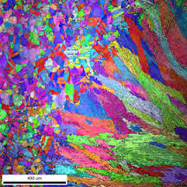
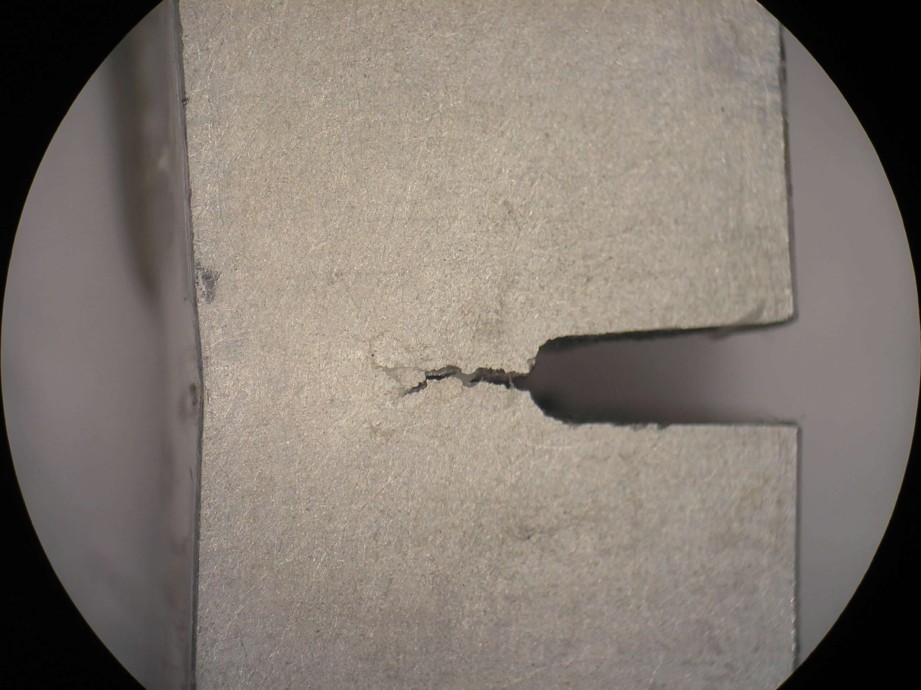
The properties and performance of a material are a result of factors across various length scales
Chemical bonds
Crystal structure
Defect interactions
Microstructure
Material properties and performance

Slide 6
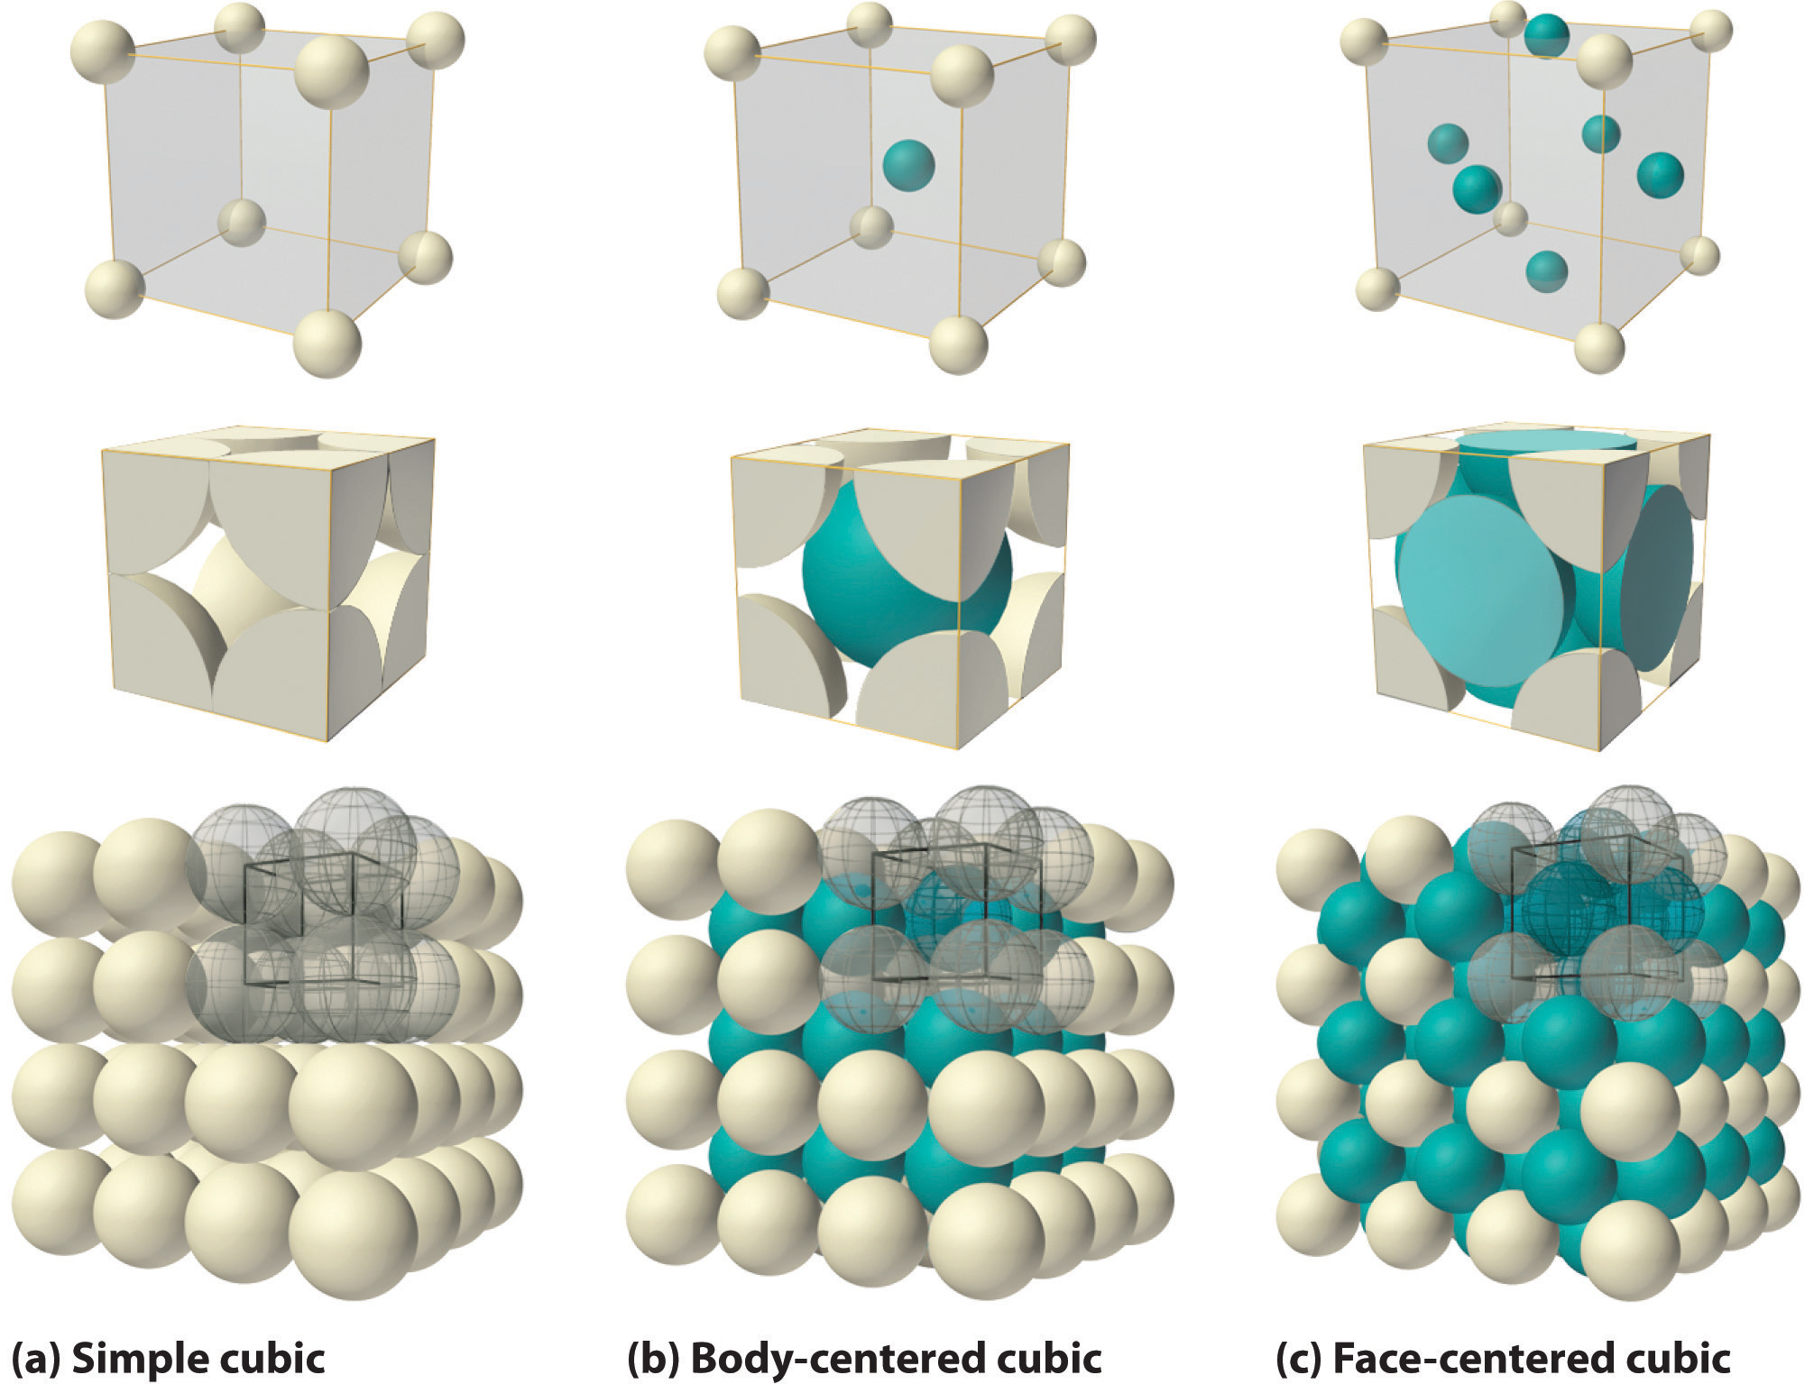
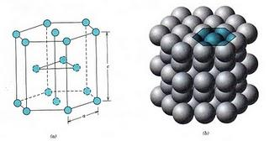
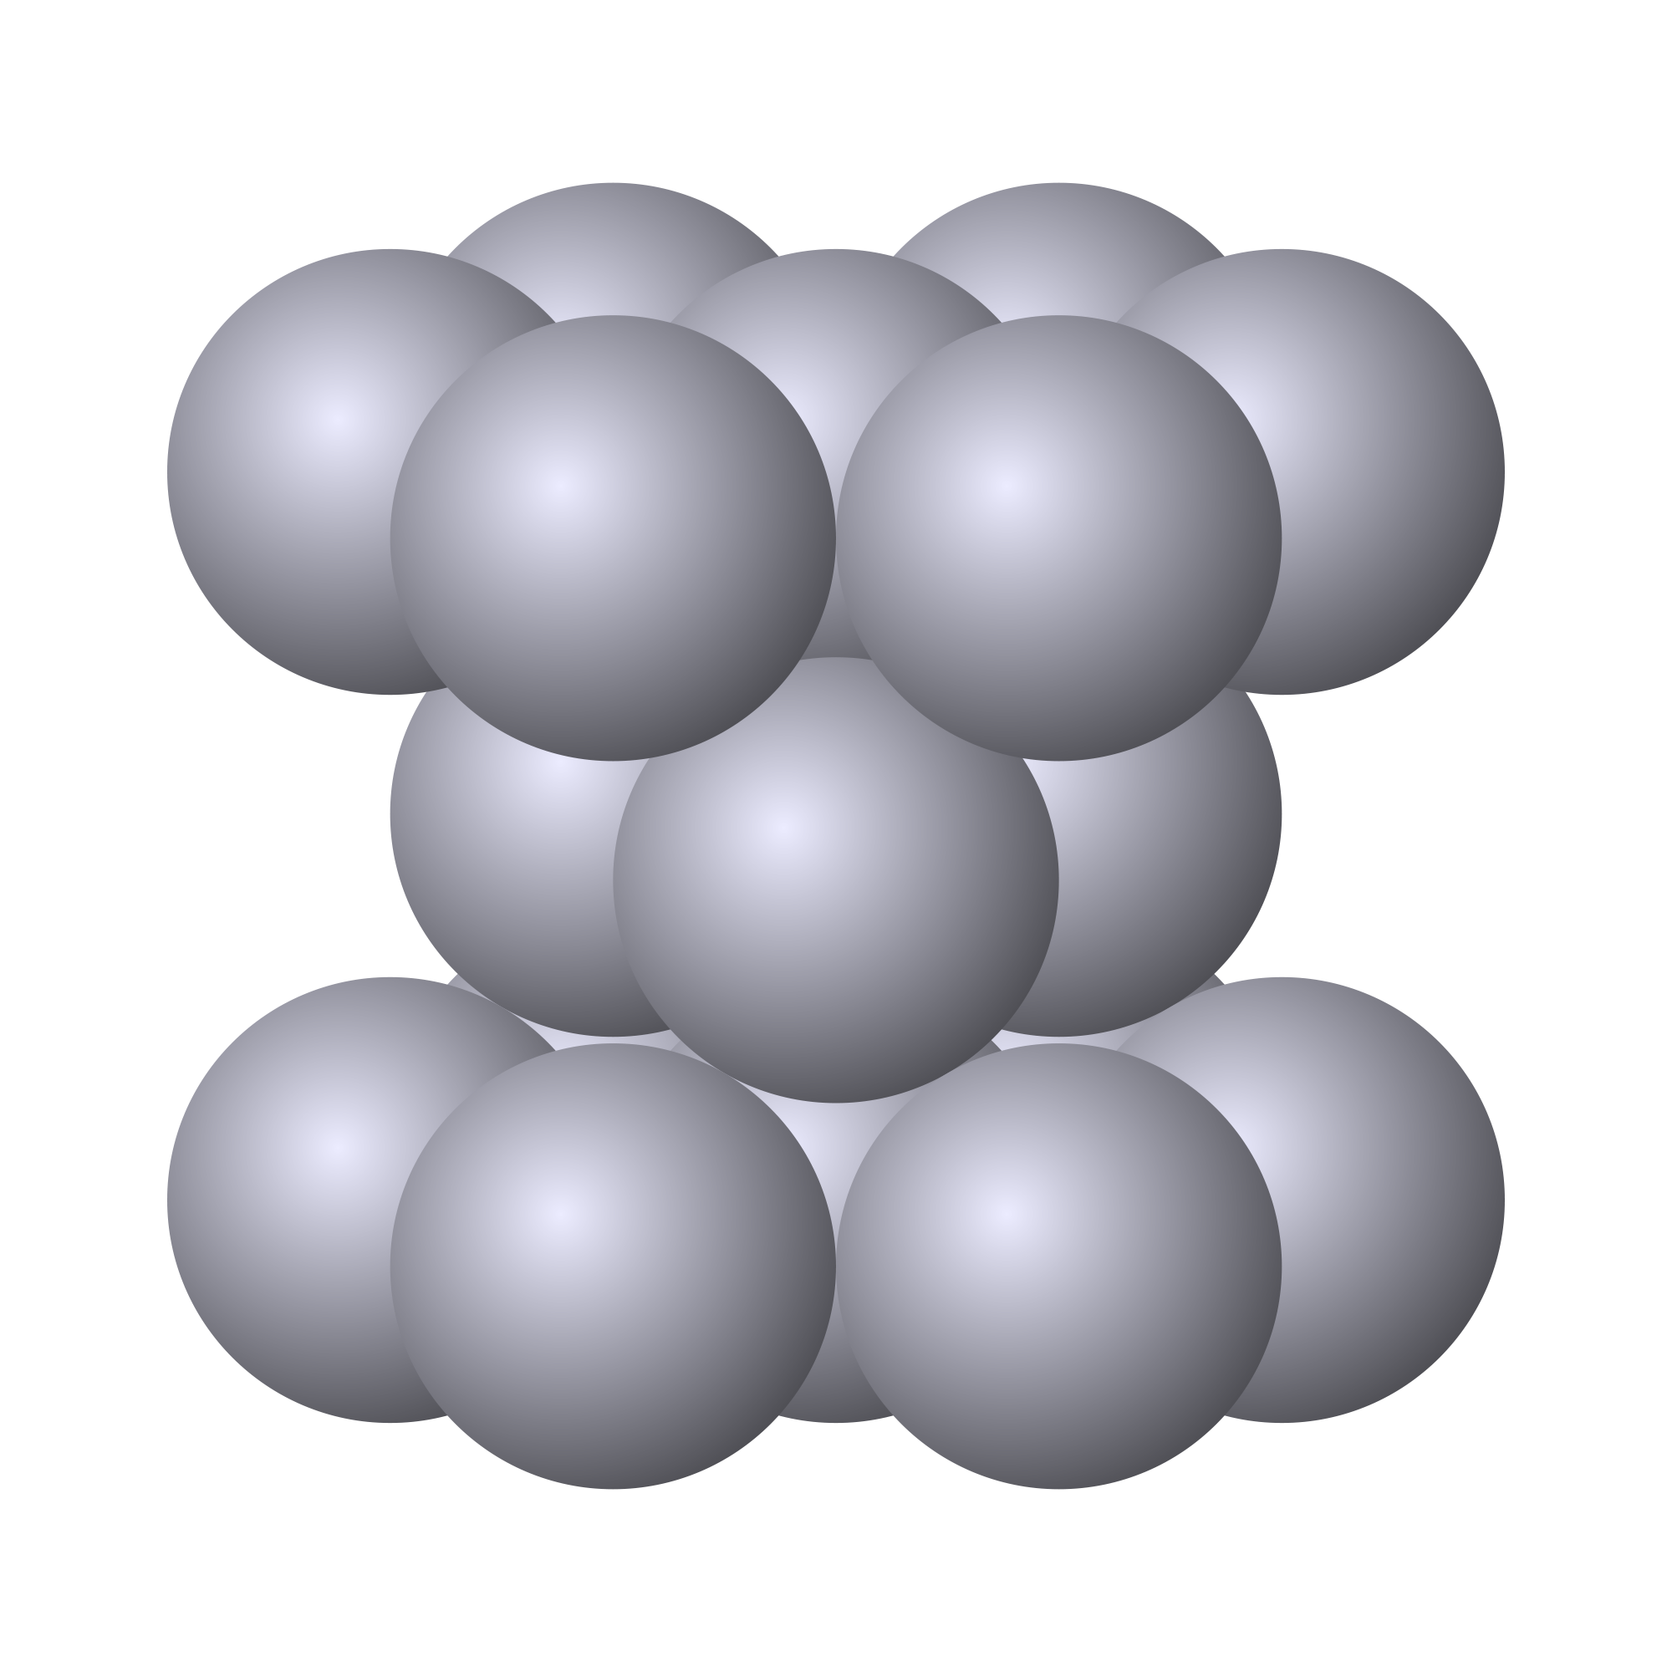
The crystal structure of a material is the shape of the ordered structure of the atoms
The atoms of many materials form an organized lattice, these are called crystalline materials. All reactor materials are crystalline.
The configuration of the atoms in the lattice impacts the properties of the material (density, thermal expansion coefficient, elastic modulus, etc.)
All major nuclear materials are either cubic or hexagonal
(d) Hexagonal close packed

Slide 7
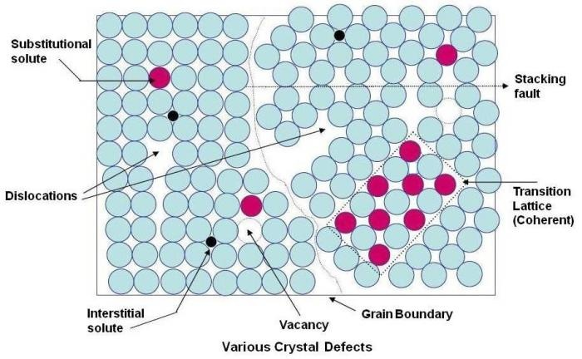
Crystalline materials
In crystalline materials, the lattices are not perfect, they have defects
Defects can be 0D, 1D, 2D, 3D
The interactions between defects seriously impact material properties and how they perform

Slide 8
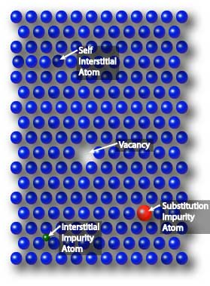
Point defects
Point defects (zero-dimensional defects) are lattice imperfections related to one or two lattice sites
There are several types of point defects
Vacancies
Self interstitial atoms (SIA)
Interstitial impurity atoms
Substitution impurity atoms
Point defects control the mobility of atoms and, therefore influence all processes that depend on diffusion

Slide 9
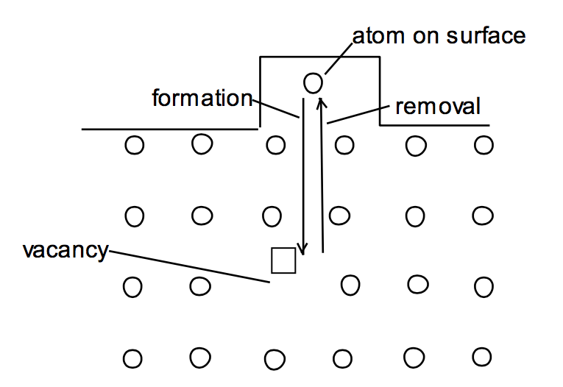
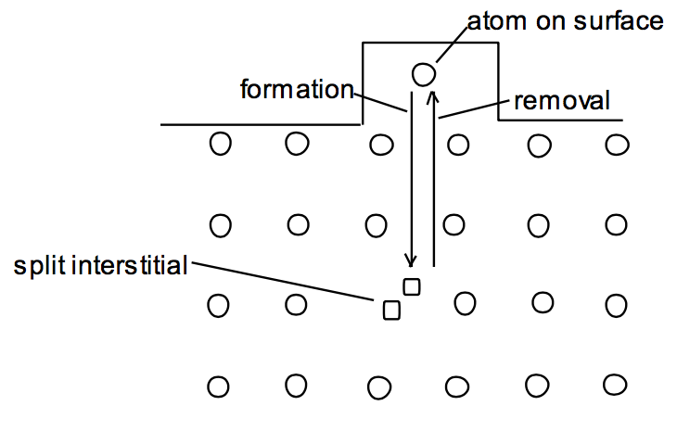
Point defects
Vacancies and interstitials form naturally in materials
Extra atoms can sit on a surface, creating a vacancy, or a surface can have a missing atom, creating a self interstitial atom (SIA)
We define the number of vacancies or interstitials in terms of a concentration. Total number of atoms is N
There exists an equilibrium concentration of point defects

Slide 10
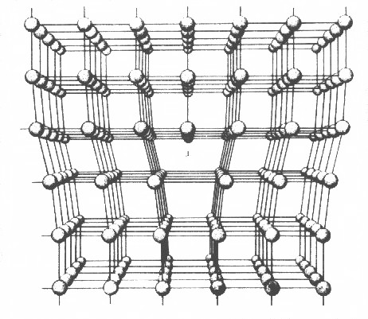
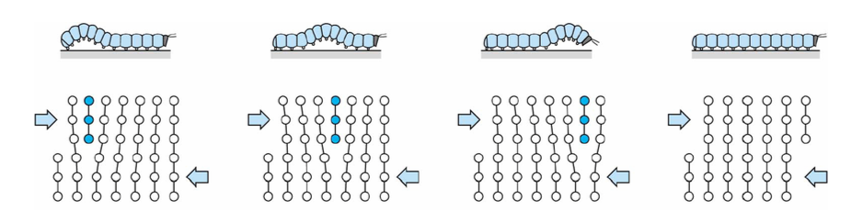
Dislocations are imperfections associated with a line of lattice sites (1D defect)
In a dislocation, an extra half plane of atoms is inserted into the lattice
When it moves, only a small number of bonds are broken at a time
Dislocation motion controls the plastic (permanent) deformation of crystalline materials

Slide 11
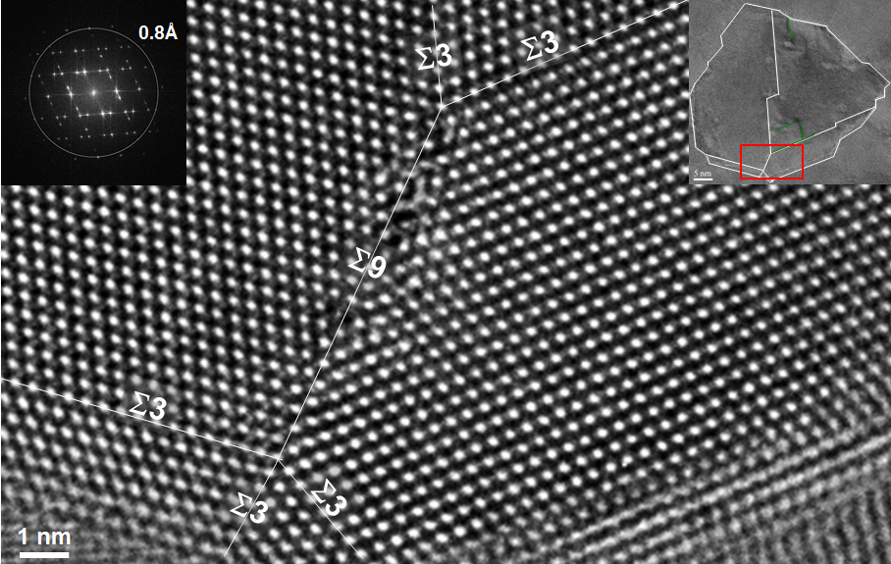
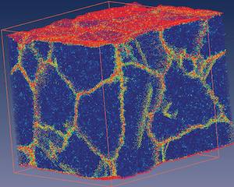
Grain boundaries
Materials are typically composed of various regions where the crystal lattice is oriented differently. These regions are called grains
When two grains meet, there is a plane of atoms that do not follow the crystal lattice called a grain boundary
Most crystalline materials are polycrystalline, not single crystal
High-res transmission eleectron microscopy can also show individual atoms (palladium)
www.knmf.kit.edu/TEM.php
Atomistic simulation of grain boundaries in 3D

Slide 12
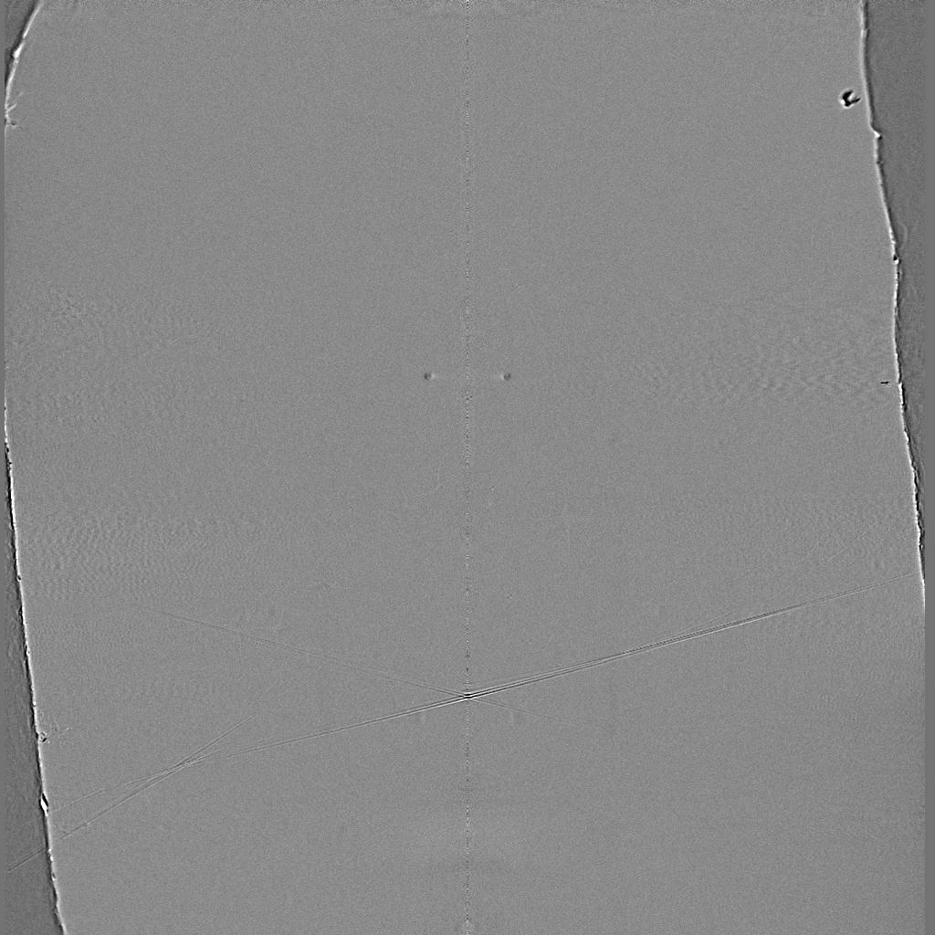
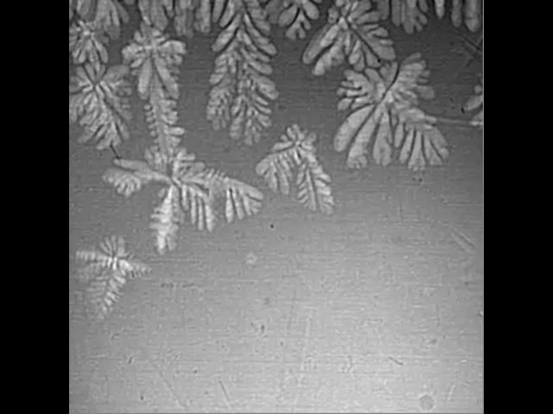
Metals are often cast, and polycrystals naturally form during casting

